Slide 1
AWS
Week 7

Slide 2
No class next week Do the mid-term
Next class will be Wednesday March 23
Needs to be updated

Slide 3
Start here
https://aws.amazon.com

Slide 4
AWS
Control satellite communication
Regions
Payment method
Services
IaaS, PaaS, SaaS
Scaling and elasticity
Administration cost = 0$

Slide 5
Doesn’t do
Penetration Testing

Slide 6
Six Advantages of Cloud Computing
Trade fixed expense for variable expense
Pay-as-you-go
Benefit from massive economies of scale
Stop guessing capacity
Increase speed and agility
Stop spending money running and maintaining data centers
Go global in minutes
Notes:
– Instead of having to invest heavily in data centers and servers before you know how you’re going to use them, you can pay only when you consume computing resources, and pay only for how much you consume.
– By using cloud computing, you can achieve a lower variable cost than you can get on your own. Because usage from hundreds of thousands of customers is aggregated in the cloud, providers such as AWS can achieve higher economies of scale, which translates into lower pay as-you-go prices.
– Eliminate guessing on your infrastructure capacity needs. When you make a capacity decision prior to deploying an application, you often end up either sitting on expensive idle resources or dealing with limited capacity. With cloud computing, these problems go away. You can access as much or as little capacity as you need, and scale up and down as required with only a few minutes’ notice.
– In a cloud computing environment, new IT resources are only a click away, which means that you reduce the time to make those resources available to your developers from weeks to just minutes. This results in a dramatic increase in agility for the organization, since the cost and time it takes to experiment and develop is significantly lower.
– Focus on projects that differentiate your business, not the infrastructure. Cloud computing lets you focus on your own customers, rather than on the heavy lifting of racking, stacking, and powering servers.
– Easily deploy your application in multiple regions around the world with just a few clicks. This means you can provide lower latency and a better experience for your customers at minimal cost.

Slide 7
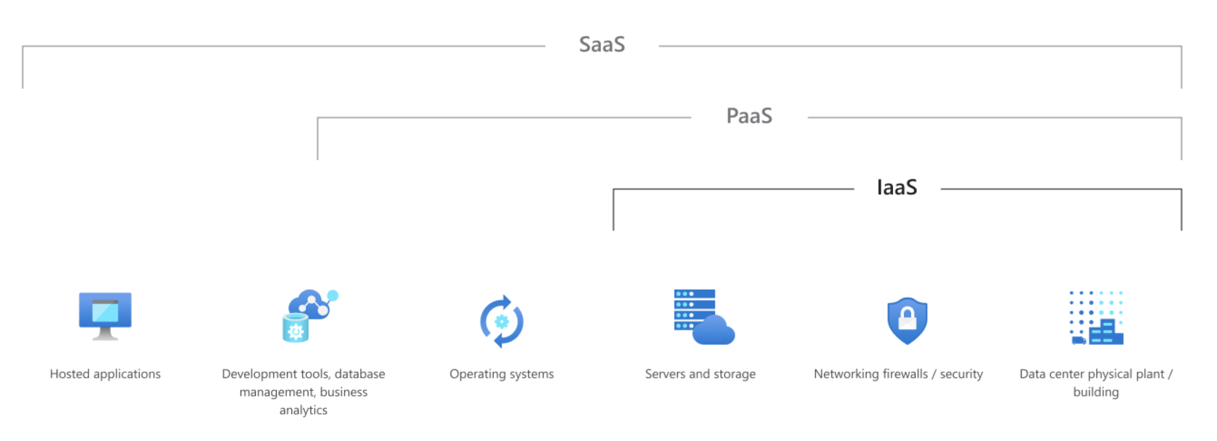

Slide 8
Common Business IaaS Scenarios
Lift-and-shift migration
Without refactoring your underlying architecture, you can increase the scale and performance, enhance the security, and reduce the costs of running an application or workload.
Test and development
IaaS makes it quick and economical to scale dev/test environments up and down.
Storage, backup, and recovery
Your organization avoids the capital outlay for storage and the complexity of storage management. IaaS is useful for handling unpredictable demand and steadily growing storage needs.

Slide 9
Common Business IaaS Scenarios
Web apps
IaaS provides all the infrastructure to support web apps, including storage, web and application servers, and networking resources. Quickly deploy and scale (up or down)
High-performance computing
High-performance computing on supercomputers, computer grids, or computer clusters helps solve complex problems involving millions of variables or calculations.

Slide 10
Advantages of IaaS
Reduces capital expenditures and optimizes cost
Increases scale and performance of IT workloads
Increases stability, reliability, and supportability
Improves business continuity and disaster recovery
HA, SLA, Business Continuity, Disaster Recovery
Enhances security
Helps you innovate and get new apps to users faster

Slide 11
Common PaaS Scenarios
Development framework.
Developers can build upon to develop or customize cloud-based applications. PaaS lets developers create applications using built-in software components. Cloud features such as scalability, high-availability, and multi-tenant capability are included, reducing the amount of coding that developers must do.
Analytics or business intelligence.
Provides tools to analyze and mine their data
Additional services.
workflow, directory, security, and scheduling.

Slide 12
Advantages of PaaS
Cut coding time. .
Add development capabilities without adding staff.
Develop for multiple platforms—including mobile—more easily.
Use sophisticated tools affordably.
A pay-as-you-go model. Use it before paying $$$$
Support geographically distributed development teams.
Efficiently manage the application lifecycle.
application lifecycle: building, testing, deploying, managing, and updating within the same integrated environment.

Slide 13
Common SaaS scenarios
Email SaaS: Outlook, Hotmail, or Yahoo!
Access account, email and storage via a browser from anywhere
Email software is located on the service provider’s network
You get the service for free, in return they get to read your email and market to you
Your business can rent apps, such as email, collaboration, and calendaring; customer relationship management (CRM), enterprise resource planning (ERP), and document management.
You pay by subscription or according to the level of use.

Slide 14
Benefits of AWS Security
Keep Your Data Safe
Meet Compliance Requirements
SOC 1/ISAE 3402, SOC 2, SOC 3
FISMA, DIACAP, and FedRAMP
PCI DSS Level 1
ISO 9001, ISO 27001, ISO 27017, ISO 27018
Save Money: delegate the complexities of security
Scale Quickly

Slide 15
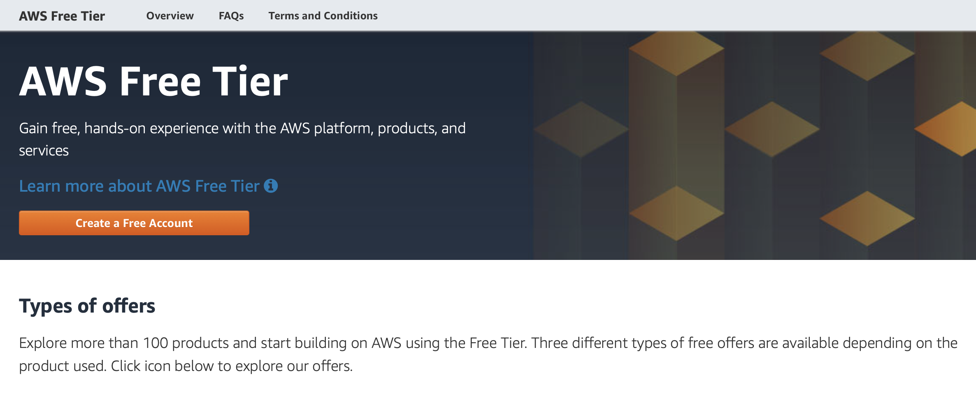

Slide 16
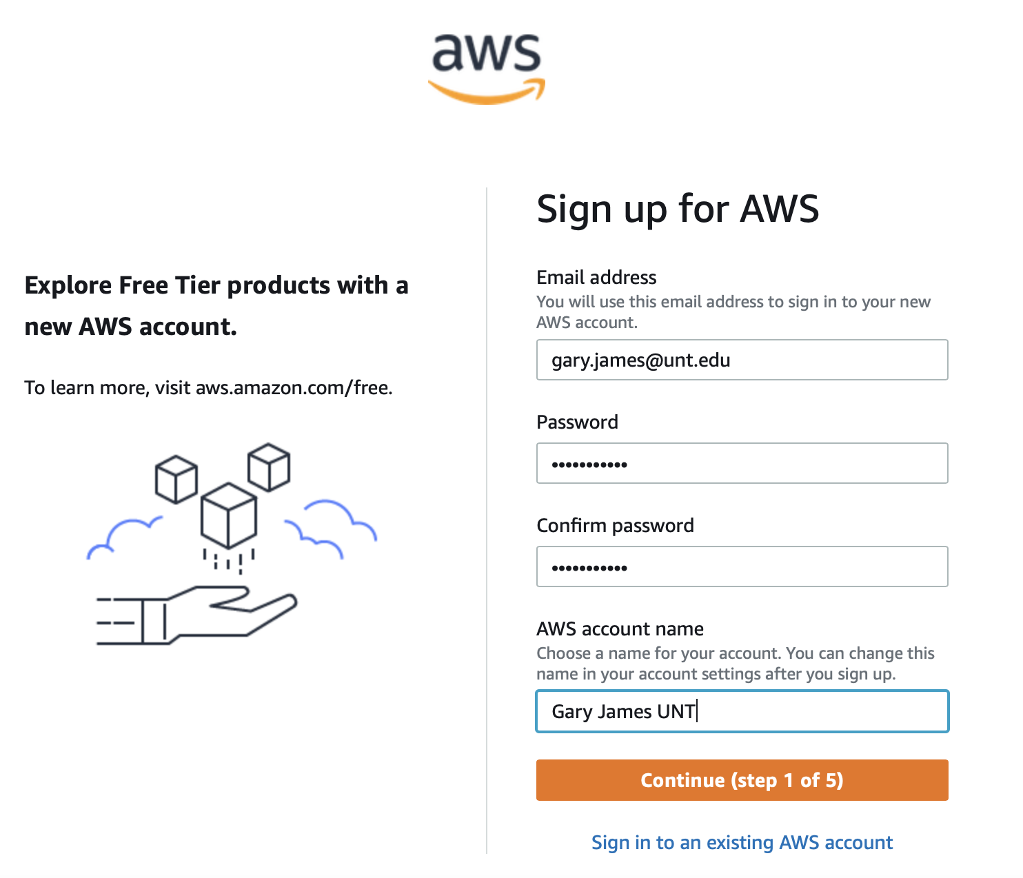
Sign up for AWS

Slide 17
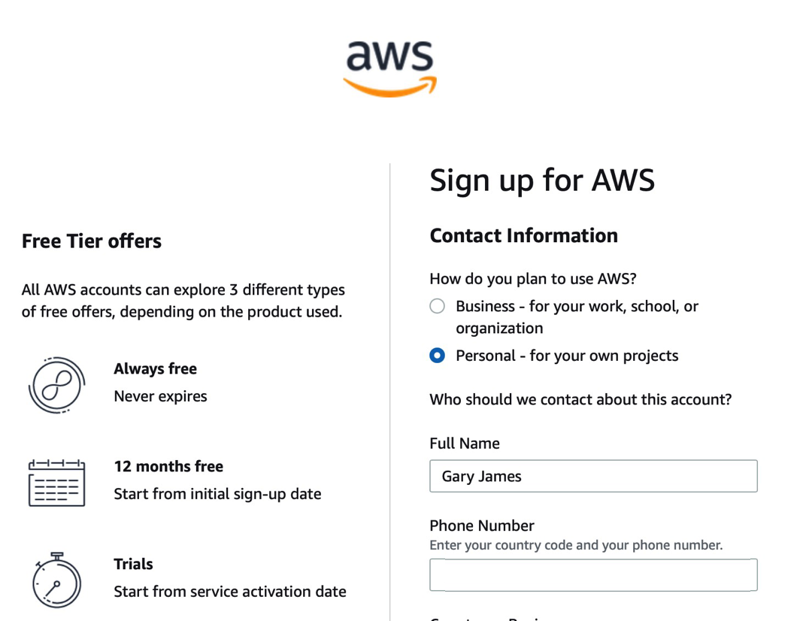
Sign up for AWS

Slide 18
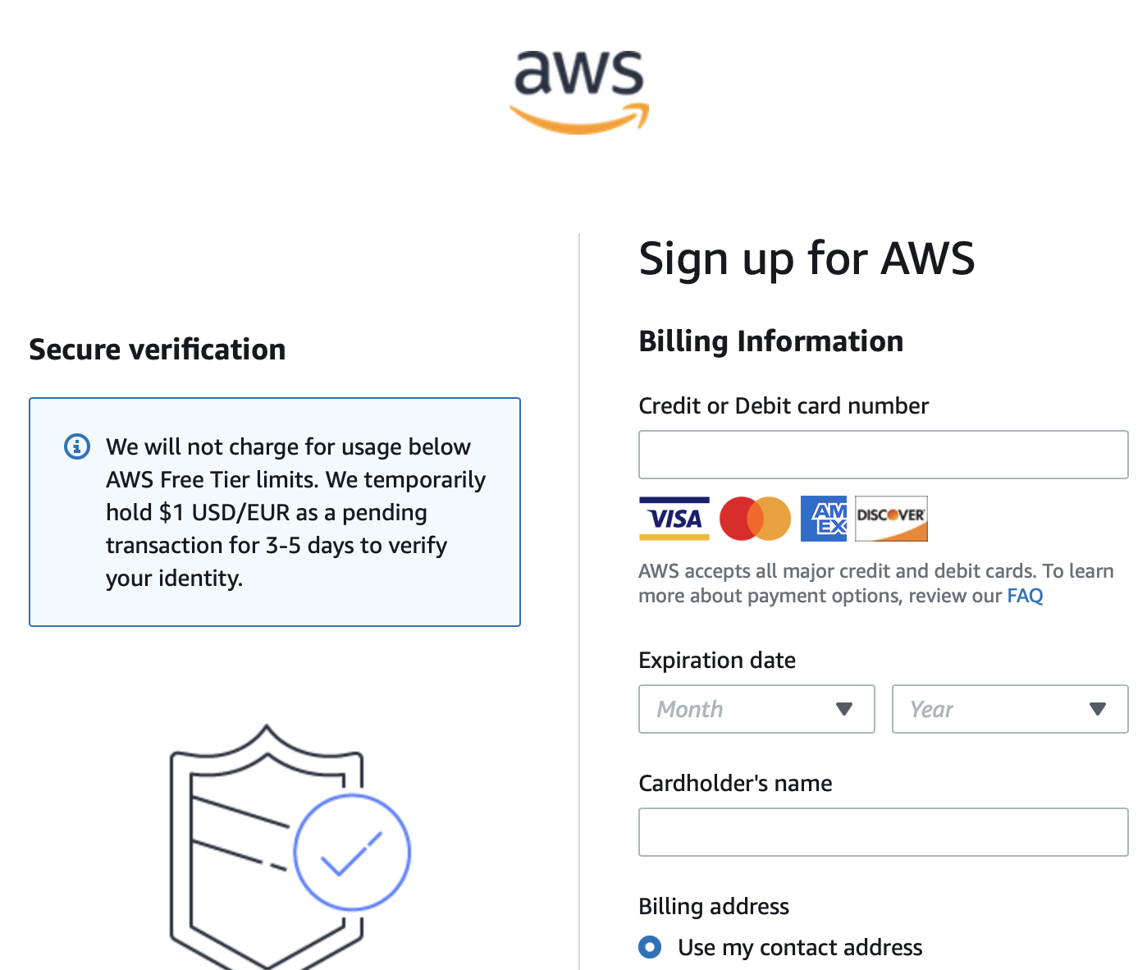
Provide a Credit Card
They will not be charging you
You won’t be building anything that big

Slide 19
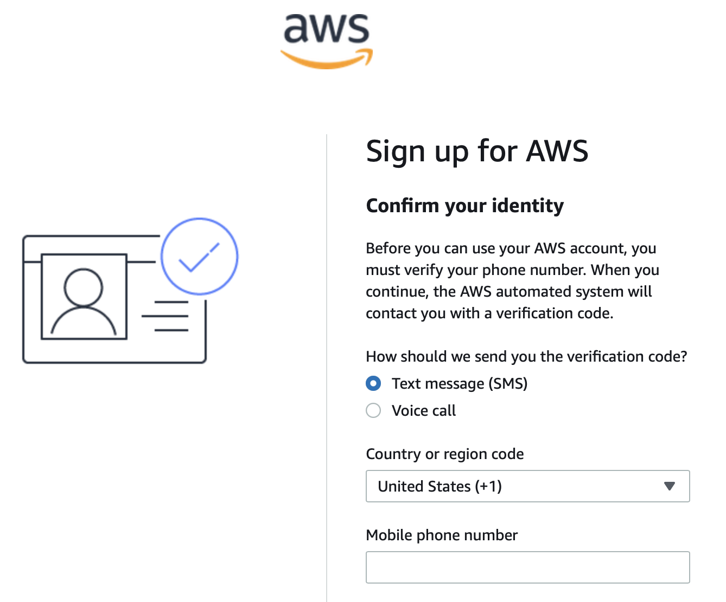
Confirm your Identity

Slide 20
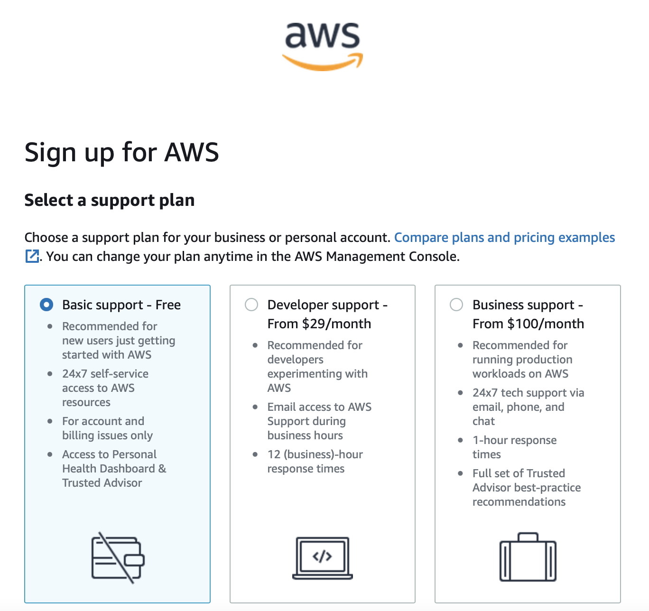
Select a support plan
There is A LOT you can do for free

Slide 21
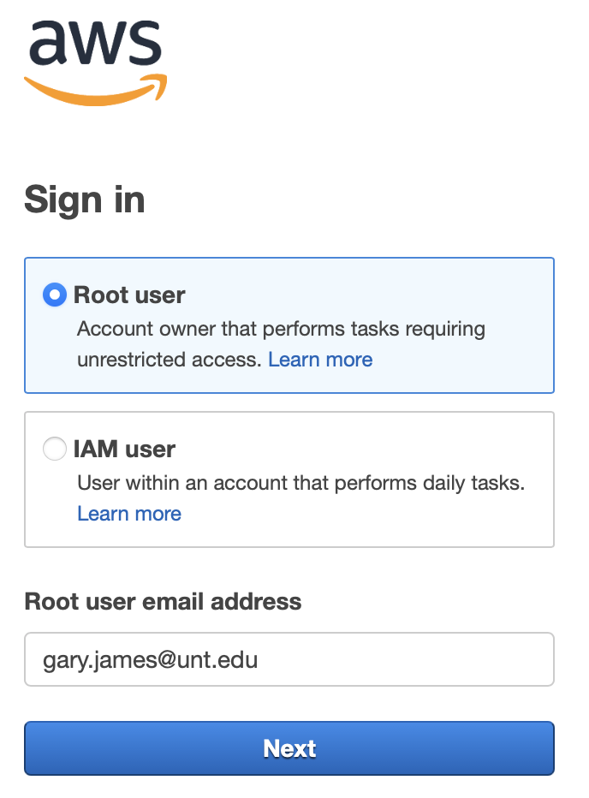
Finally, you can sign in

Slide 22
AWS Management Console
A static website typically uses a server-side language such as PHP or Node.js
Bootstrap includes all of the PHP and NodeJS files needed for creating the server-side of an interactive site
Bootstrap resources would be considered client-side rather than server-side.

Slide 23
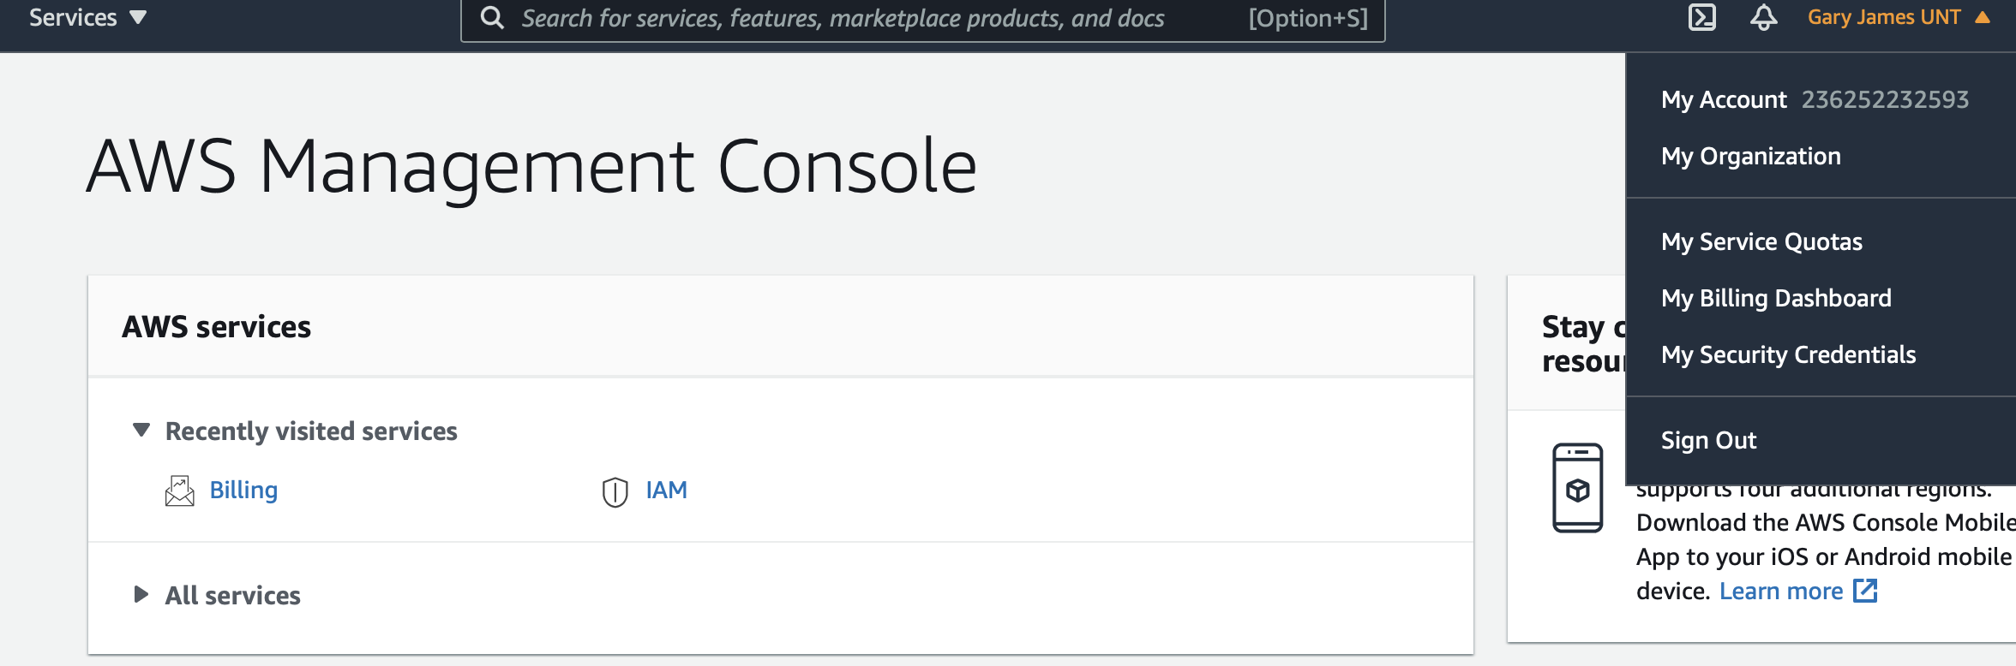
This week’s assignment to to prove You have an AWS account

